Slide 1
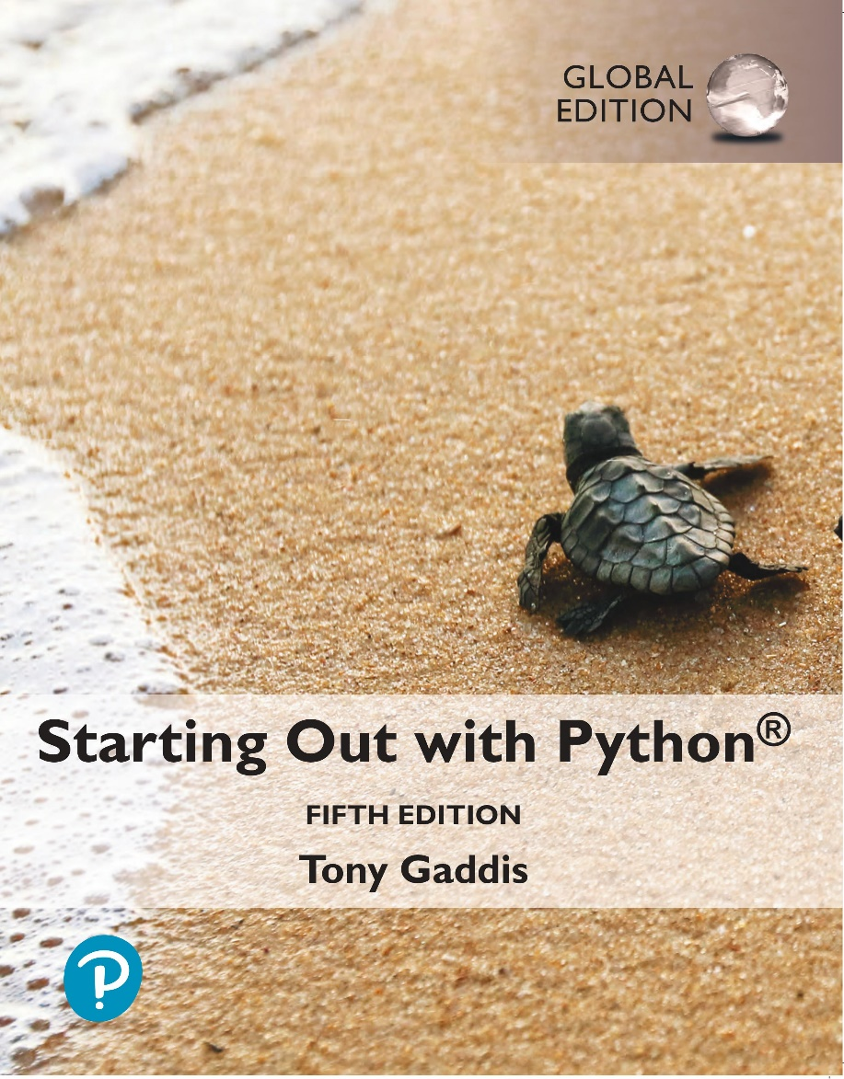
Starting out with Python
Fifth Edition, Global Edition
Chapter 7
Lists and Tuples
Copyright © 2022 Pearson Education, Ltd. All Rights Reserved.

Slide 2
Topics (1 of 2)
Sequences
Introduction to Lists
List Slicing
Finding Items in Lists with the in Operator
List Methods and Useful Built-in Functions

Slide 3
Topics (2 of 2)
Copying Lists
Processing Lists

Slide 4
Sequences
Sequence: an object that contains multiple items of data
The items are stored in sequence one after another
Python provides different types of sequences, including lists and tuples
The difference between these is that a list is mutable and a tuple is immutable

Slide 5
Introduction to Lists (1 of 2)
List: an object that contains multiple data items
Element: An item in a list
Format: list = [item1, item2, etc.]
Can hold items of different types
print function can be used to display an entire list
list() function can convert certain types of objects to lists

Slide 6
Introduction to Lists (2 of 2)
Figure 7-1 A list of integers
Figure 7-2 A list of strings
Figure 7-3 A list holding different types

Slide 7
The Repetition Operator and Iterating over a List
Repetition operator: makes multiple copies of a list and joins them together
The * symbol is a repetition operator when applied to a sequence and an integer
Sequence is left operand, number is right
General format: list * n
You can iterate over a list using a for loop
Format: for x in list:

Slide 8
Indexing
Index: a number specifying the position of an element in a list
Enables access to individual element in list
Index of first element in the list is 0, second element is 1, and n’th element is n-1
Negative indexes identify positions relative to the end of the list
The index -1 identifies the last element, -2 identifies the next to last element, etc.

Slide 9
The len function
An IndexError exception is raised if an invalid index is used
len function: returns the length of a sequence such as a list
Example: size = len(my_list)
Returns the number of elements in the list, so the index of last element is len(list)-1
Can be used to prevent an IndexError exception when iterating over a list with a loop

Slide 10
Lists Are Mutable (1 of 2)
Mutable sequence: the items in the sequence can be changed
Lists are mutable, and so their elements can be changed
An expression such as
list[1] = new_value can be used to assign a new value to a list element
Must use a valid index to prevent raising of an IndexError exception

Slide 11
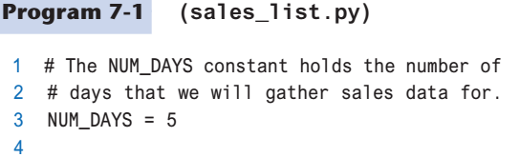
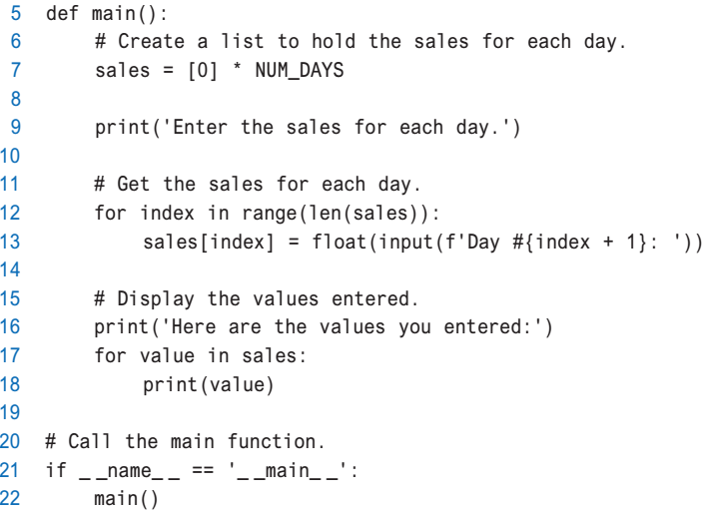
Lists Are Mutable (2 of 2)

Slide 12
Örnek
Soru: Önce bir sınıftaki öğrenci sayısını daha sonra öğrencilerin notlarını kullanıcıdan alan ve sınıf not ortalamasının üstünde olan öğrenci notlarını listeleyen algoritma:

Slide 13
Concatenating Lists
Concatenate: join two things together
The + operator can be used to concatenate two lists
Cannot concatenate a list with another data type, such as a number
The += augmented assignment operator can also be used to concatenate lists

Slide 14
List Slicing
Slice: a span of items that are taken from a sequence
List slicing format: list[start : end]
Span is a list containing copies of elements from start up to, but not including, end
If start not specified, 0 is used for start index
If end not specified, len(list) is used for end index
Slicing expressions can include a step value and negative indexes relative to end of list

Slide 15
Finding Items in Lists with the in Operator (1 of 2)
You can use the in operator to determine whether an item is contained in a list
General format: item in list
Returns True if the item is in the list, or False if it is not in the list
Similarly you can use the not in operator to determine whether an item is not in a list

Slide 16
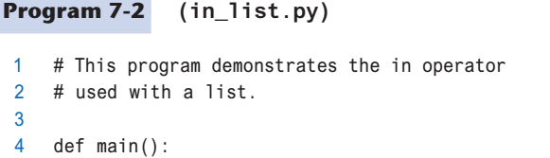
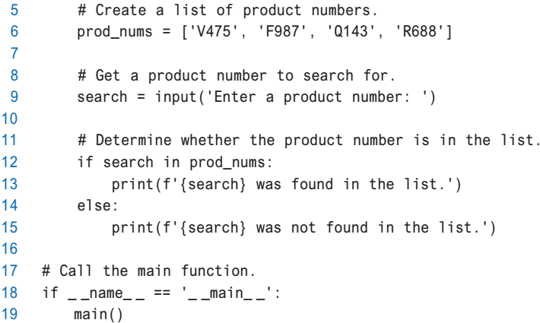
Finding Items in Lists with the in Operator (2 of 2)

Slide 17
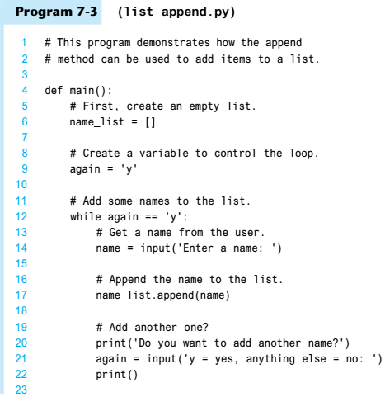
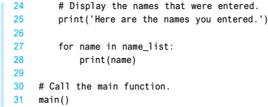
List Methods and Useful Built-in Functions (1 of 6)
append(item): used to add items to a list – item is appended to the end of the existing list

Slide 18
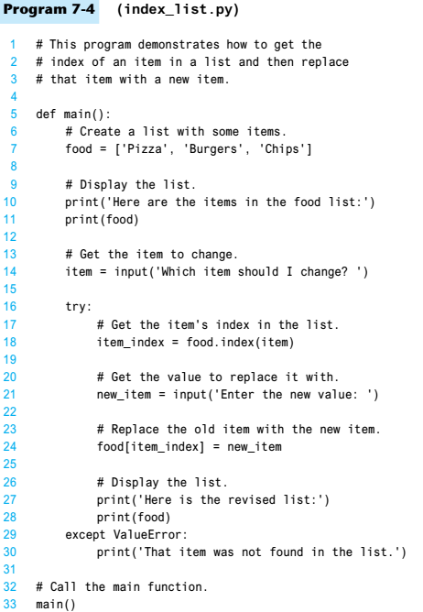
List Methods and Useful Built-in Functions (2 of 6)
index(item): used to determine where an item is located in a list
Returns the index of the first element in the list containing item
Raises ValueError exception if item not in the list

Slide 19
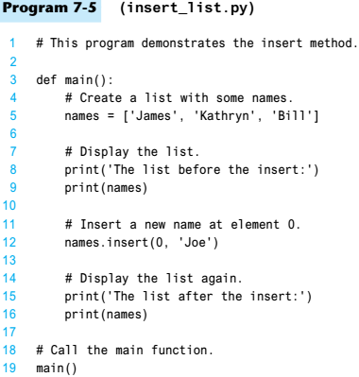
List Methods and Useful Built-in Functions (3 of 6)
insert(index, item): used to insert item at position index in the list
sort(): used to sort the elements of the list in ascending order

Slide 20
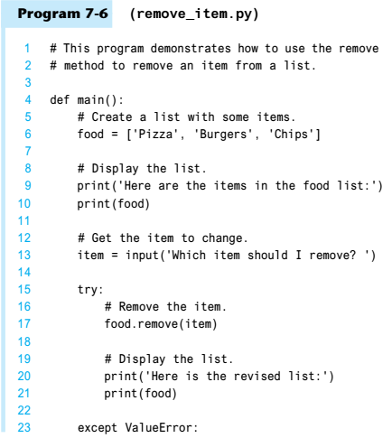

List Methods and Useful Built-in Functions (4 of 6)
remove(item): removes the first occurrence of item in the list
reverse(): reverses the order of the elements in the list

Slide 21
List Methods and Useful Built-in Functions (5 of 6)
Table 7-1 A few of the list methods
Method | Description
append(item) | Adds item to the end of the list.
index(item) | Returns the index of the first element whose value is equal to item. A ValueError exception is raised if item is not found in the list.
insert(index, item) | Inserts item into the list at the specified index. When an item is inserted into a list, the list is expanded in size to accommodate the new item. The item that was previously at the specified index, and all the items after it, are shifted by one position toward the end of the list. No exceptions will occur if you specify an invalid index. If you specify an index beyond the end of the list, the item will be added to the end of the list. If you use a negative index that specifies an invalid position, the item will be inserted at the beginning of the list.
sort() | Sorts the items in the list so they appear in ascending order (from the lowest value to the highest value).
remove(item) | Removes the first occurrence of item from the list. A ValueError exception is raised if item is not found in the list.
reverse() | Reverses the order of the items in the list.

Slide 22
List Methods and Useful Built-in Functions (6 of 6)
del statement: removes an element from a specific index in a list
General format: del list[i]
min and max functions: built-in functions that returns the item that has the lowest or highest value in a sequence
The sequence is passed as an argument

Slide 23
Copying Lists (1 of 2)
To make a copy of a list you must copy each element of the list
Two methods to do this:
Creating a new empty list and using a for loop to add a copy of each element from the original list to the new list
Creating a new empty list and concatenating the old list to the new empty list

Slide 24

Copying Lists (2 of 2)
Figure 7-5 list1 and list2 reference the same list

Slide 25
Processing Lists (1 of 2)
List elements can be used in calculations
To calculate total of numeric values in a list use loop with accumulator variable
To average numeric values in a list:
Calculate total of the values
Divide total of the values by len(list)
List can be passed as an argument to a function

Slide 26
Processing Lists (2 of 2)
A function can return a reference to a list
To save the contents of a list to a file:
Use the file object’s writelines method
Does not automatically write \n at then end of each item
Use a for loop to write each element and \n
To read data from a file use the file object’s readlines method

Slide 27
Örnek
Soru: Bir fabrikadaki 1-10 arasında numaralandırılmış makinaların 30 günlük üretim verilerini makina numarasına göre sıralı olarak kullanıcıdan alan, her makinanın aylık üretim miktarını ve fabrikanın aylık üretim miktarını bulan algoritma:

Slide 28
Örnek
Soru: Bir fabrikadaki 1-10 arasında numaralandırılmış makinaların 30 günlük üretim verilerini gün numarasına göre sıralı olarak kullanıcıdan alan, her makinanın aylık üretim miktarını ve fabrikanın aylık üretim miktarını bulan algoritma:

Slide 29
Örnek
Soru: Bir tavla zarının 1000 kez atılması sonucunda gelen sayıları kullanıcıdan alan, zarın yüzlerindeki sayıların kaçar kez geldiklerini, en çok gelen sayıyı ve kaç kez geldiğini bulan algoritma:

Slide 30
Örnek
Soru: Bir askeri birlikteki her askerin ayak numarasını (37-46) ve beden numarasını (50, 52, …, 60) kullanıcıdan alan, her numaradan kaç postal ve her bedenden kaç giysi tedarik edilmesi gerektiğini bulan algoritma:

Slide 31
Örnek
Soru: Bir sınıftaki öğrencilerin notlarını (0-100) kullanıcıdan alan ve 0-9, 10-19, …, 80-89, 90-100 not aralıklarındaki öğrenci sayılarını bulan algoritma:

Slide 32
Summary
This chapter covered:
Lists, including:
Repetition and concatenation operators
Indexing
Techniques for processing lists
Slicing and copying lists
List methods and built-in functions for lists

